Slide 1
Project Robo-trade Automatic trading of cryptocurrency based on sentiment
Joe DiFransesco, Barthélémy Ghez & Arjen van den Heuvel

Slide 2
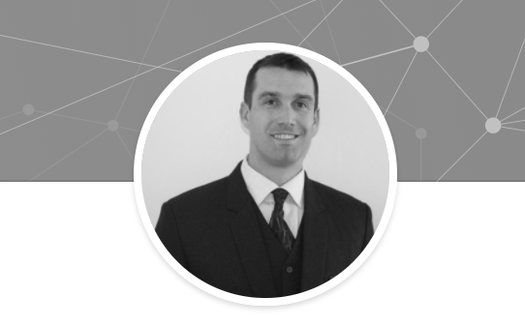

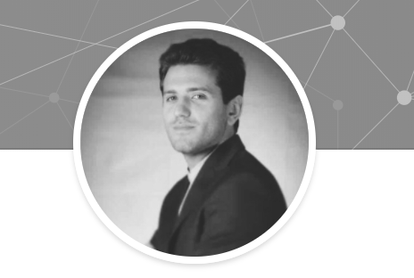
The Team
Joe DiFransesco
Arjen van den Heuvel
Barthélémy Ghez

Slide 3
Business Question
Can we automate cryptocurrency-trading based on the assumption that news- and discussion websites drives the exchange prices?

Slide 4
Contents
1. Project Design
2. Current Status
3.Tools
Appendix

Slide 5
1.
Project Design

Slide 6
Project Design (1/2)
Webscraper
Using a web scraper, data is periodically collected from around 20 specifically targeted websites. These are monitored for keywords concerning Bitcoin, Ethereum and Litecoin.
Cleaning
After cleaning up this text, and concatenating the title and content where applicable, a sentiment analysis is run. The cleaned text is also used as a basis for querying a sandbox bitcoin trading environment for the current trading prices simultaneously through an API.
Sentiment analysis
Sentiment analysis will consist of a combination of a more straightforward approach and the use of indicator words as separate sentiment predictors (i.e. bubble, country names, opportunity)
Other predictors
Separate from this we will pinpoint several other predictors such as total trading volume, stock prices etc.
Server
Websites
Scraper
Text Cleaning
Price Query
Translate
Exchange API
Date Cleaning
Price Query
Additional Predictors
Concatenation
Predictor Query
Split DF Into Separate Predictor DFs
Sentiment Analysis
Client
Sentiment Predictors Compiled
Additional Predictors
User Input
I₁
I₂
I₃
I₄
I₅
I₆
I₇
I_{N}
NN Model
Market Prediction + Confidence
Exchange API
Current Wallet Positions
Buy/Sell Function
Execute Trade
Exchange API
Status Function
Monitor Trade Status
Client
Output Status
History
Charts
Summary

Slide 7
Server
Websites
Scraper
Text Cleaning
Price Query
Translate
Exchange API
Date Cleaning
Price Query
Additional Predictors
Concatenation
Predictor Query
Split DF Into Separate Predictor DFs
Sentiment Analysis
Client
Sentiment Predictors Compiled
Additional Predictors
User Input
Project Design (2/2)
Neural Network
These variables are all put into a neural network (H2O) to give weights to these predictors and sources. The end result should be two-fold ; a market prediction and a confidence or trend.
Trading
The exchange is then accessed to obtain our current wallet positions and using a to-be-developed buy/sell function, trades are executed. These are constantly monitored for the status, and feedback is given upon these results to cease or initiate (new) trades.
Feedback
As feedback to our client we provide a phone app highlighting ;
Trade history and current status
Charts with relevant information contained in the scrapes concerning sentiment.
A summary
2/2
I₁
I₂
I₃
I₄
I₅
I₆
I₇
I_{N}
NN Model
Market Prediction + Confidence
Exchange API
Current Wallet Positions
Buy/Sell Function
Execute Trade
Exchange API
Status Function
Monitor Trade Status
Client
Output Status
History
Charts
Summary

Slide 8
2.
Current status

Slide 9
Current status
Scraper (100%)
Data cleaning function (100%)
Sentiment Analysis (40%)
We are currently using a dataset of 100 000 observations, of cleaned data, to train and test our prediction model(s).

Slide 10
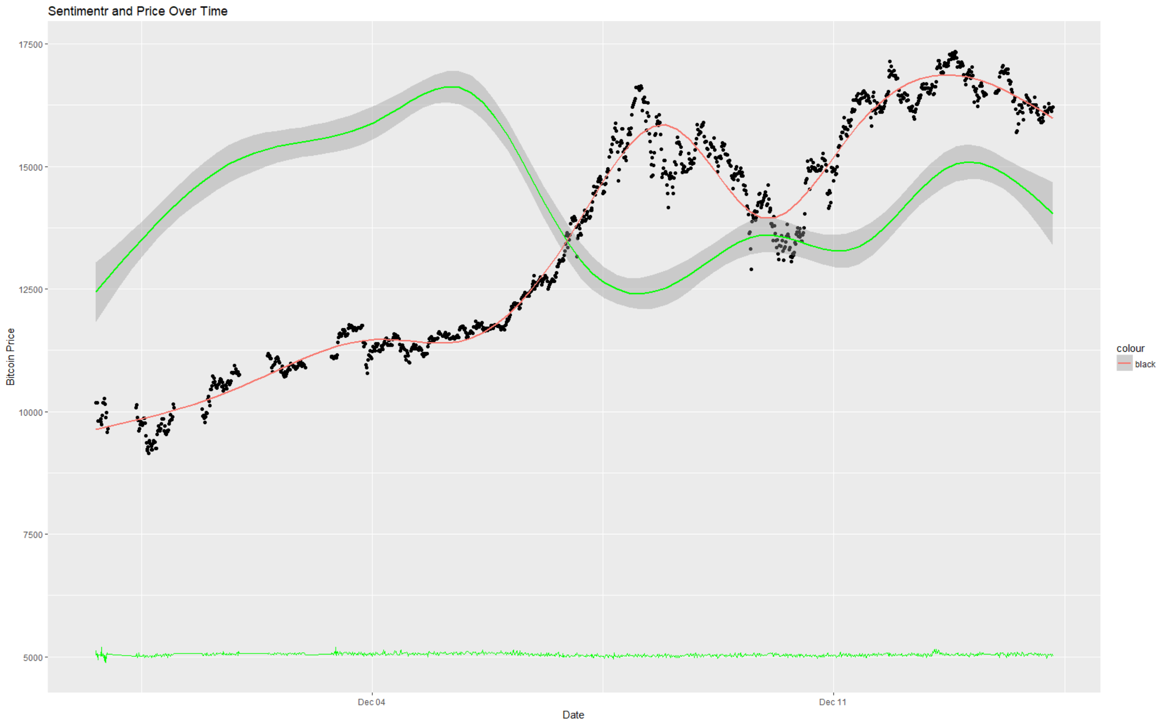
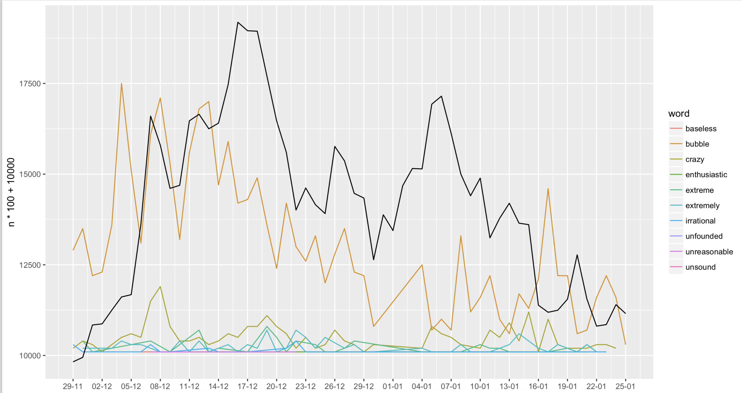

Data Exploration
A
C
E?
B
D
Initial exploration sentiment and exchange price
Indicator Word Analysis

Slide 11
3.
Tools

Slide 12
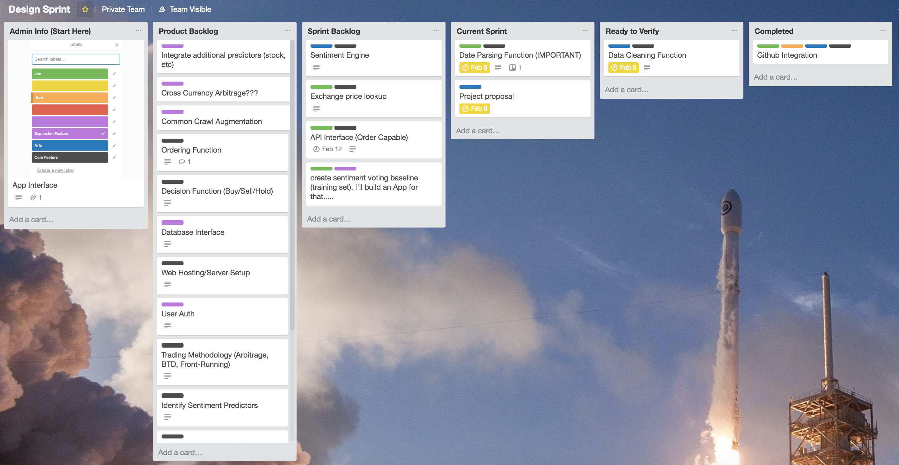
Trello
Trello is used to create and assign tasks, communicate deadlines and track progress. Sprints are weekly and end on Friday afternoon with a team wrap-up.
https://trello.com/b/cozLjiO3/design-sprint

Slide 13
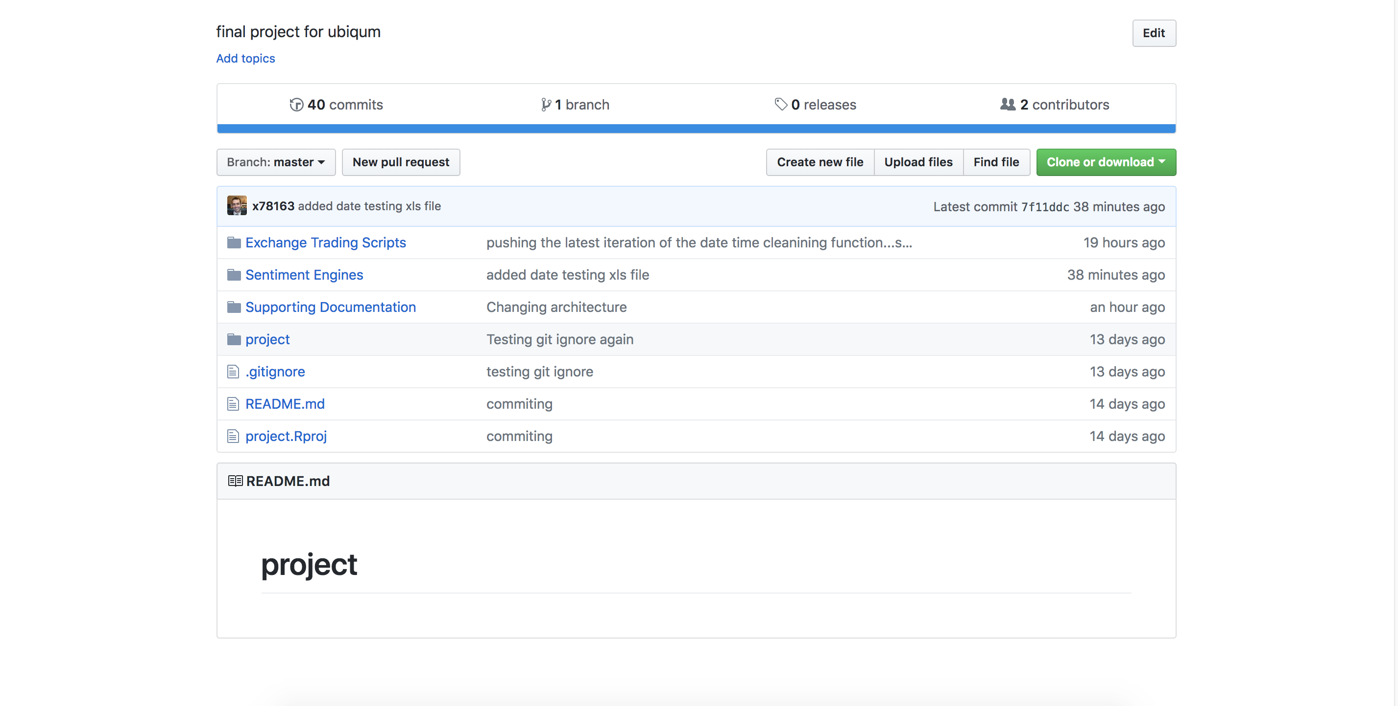
GitHub
GitHub is the repository where the team publishes their scripts, output and input and other files.
https://github.com/Ubiqum-Project/project

Slide 14
Appendix

Slide 15
Sources
* Subject to change
BBC
Bitcoin News
Bloomberg
China Daily
CNBC
Coin Desk
Crypto Coin News
Facebook BTC Group
Facebook Search
Fortune
Free Republic
Google Finance
Google Plus
India Economic Times:
Reddit BTC All
Reddit BTC Bay
Reddit BTC Markets
Reddit BTC Mining
Reddit BTC XT
Reddit Crypto
Reuters
South China Morning Post
Twitter
Wall Street Journal
Yahoo News
YouTube
Zero Hedge

Slide 16
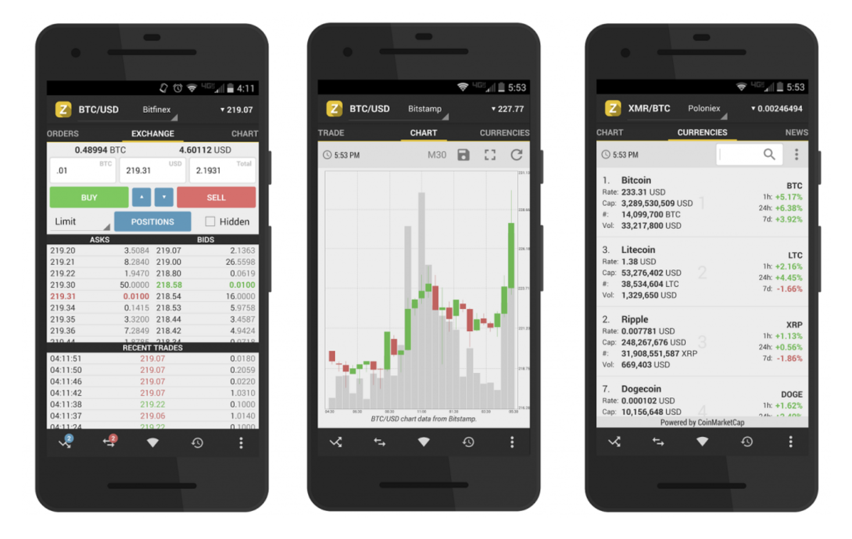
Mockup app interface

Slide 17


